Slide 1
English
Unit 2 – Sport
WALT:
6Ug.12 Use an increasing range of modal forms.
6Sc.04 Give a sequence of instructions.

Slide 2



WALT: Use an increasing range of modal forms. Give a sequence of instructions.
I can use “should”, “must” and “need to” give advice or instructions.
I can use “shouldn’t”, “mustn’t” and “don’t need” to give advice or instructions.
I can give reasons for my advice or instructions.

Slide 3
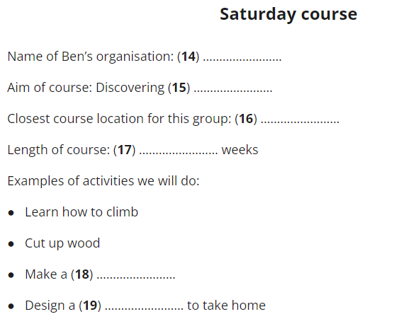
Retrieval Practice – Write the missing words on your whiteboard.
WALT: Use an increasing range of modal forms. Give a sequence of instructions.
.
https://englishpracticetest.net/practice-listening-test-for-b1-with-answer-and-audioscript-test-01/

Slide 4
Starter – Correct these sentences
WALT: Use an increasing range of modal forms. Give a sequence of instructions.
We need doing sports to keep fit.
You should happy because you will make friends.
You must very healthy.

Slide 5
Starter – Correct these sentences
WALT: Use an increasing range of modal forms. Give a sequence of instructions.
We need to do sports to keep fit.
You should be happy because you will make friends.
You must be very healthy.

Slide 6
What is the difference between advice and instructions?
WALT: Use an increasing range of modal forms. Give a sequence of instructions.
Advice is guidance or recommendations.
Instructions are directions or orders.

Slide 7
WALT: Use an increasing range of modal forms. Give a sequence of instructions.
When we give advice we use “should”
Example: You should do your homework the day you get it.
You don’t have to do your homework the day you get it, but it would be a good idea because then its out the way and you wont forget about it.

Slide 8
WALT: Use an increasing range of modal forms. Give a sequence of instructions.
When we give instructions we use “must” or “need”.
Example: You must do your homework before Friday.
You need to do you homework before Friday.
This is a rule. You have to do it.

Slide 9
WALT: Use an increasing range of modal forms. Give a sequence of instructions.
Modal Verbs
Modal verbs are verbs that indicate likelihood, ability, permission or obligation.
can/could
may/might
will/would
shall/should
must
The sea monster should go away.
In this sentence 'should' is the modal verb as it indicates the likelihood of the sea monster going away.
https://www.bbc.co.uk/bitesize/articles/zps4pbk#znyxywx

Slide 10
You can also use the negative form of should, must and need.
WALT: Use an increasing range of modal forms. Give a sequence of instructions.
You shouldn’t leave your homework to the last minute.
You mustn’t lie to your parents.
You don’t need to do all of the optional activities.

Slide 11
Be careful when using mustn’t and don’t need.
WALT: Use an increasing range of modal forms. Give a sequence of instructions.
Mustn’t is used to say you are not allowed to do something.
Example: You mustn’t run in the corridor.
Don’t need is used when you don’t have to do something but you can if you want.
Example: You don’t need to bring post it notes to school.

Slide 12
Give some advice or instructions to your partner now.
WALT: Use an increasing range of modal forms. Give a sequence of instructions.
Use should, must and need to give a sequence of advice or instructions.
Example: You need to brush your teeth twice a day.
Include shouldn’t, mustn’t and don’t need in your advice or instructions.
Example: You shouldn’t eat too much chocolate.
Give reasons for your advice or instructions.
Example: You should exercise every day to make your body fit and strong..

Slide 13
WALT: Use an increasing range of modal forms. Give a sequence of instructions.
I can use “should”, “must” and “need to” give advice or instructions.
I can use “shouldn’t”, “mustn’t” and “don’t need” to give advice or instructions.
I can give reasons for my advice or instructions.

Slide 14

Plenary – Listen to the warm up instructions again.
WALT: Use an increasing range of modal forms. Give a sequence of instructions.
Which modal forms can you hear?

